Slide 1




guestbook
Home
Discussion
Conclusion
Presented By : DevOps Team
PROJECT PLANNING & MANAGEMENT
Project Documentation Guidelines
February 25, 2025

Slide 2
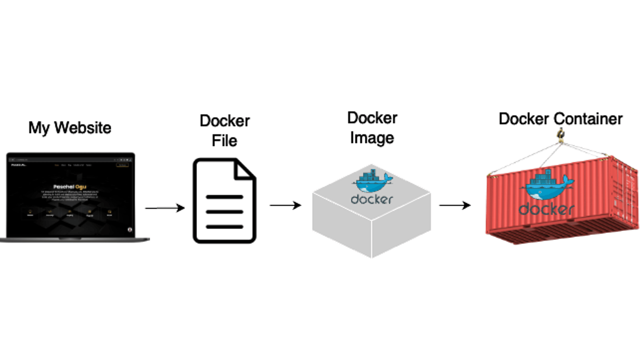
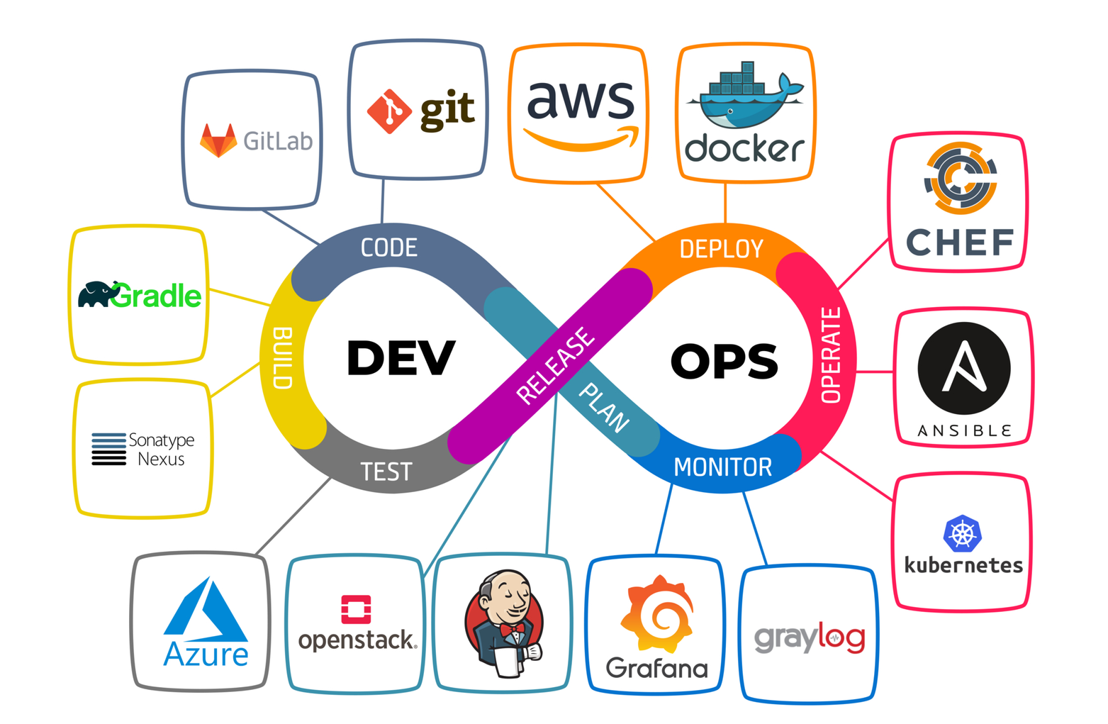
guestbook
Home
Discussion
Conclusion
PRESENTATION OBJECTIVE
Implement an automated CI/CD pipeline using Jenkins, Docker, and Ansible.

Slide 3
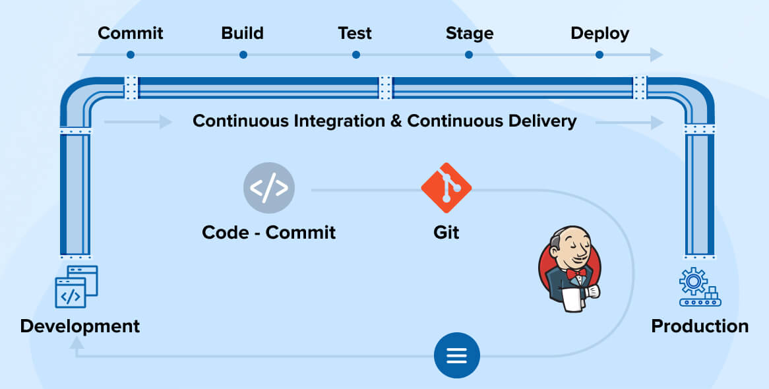
guestbook
Home
Discussion
Conclusion
PROJECT DESCRIPTION
Develop a pipeline to automate the build, testing, and deployment of a sample application. Utilize Jenkins for continuous integration, Docker for containerization, and Ansible for configuration management. Implement
automated testing and deployment to a cloud environment.

Slide 4
guestbook
Home
Discussion
Conclusion
PROJECT PLAN
TASKS
WEEK 1
WEEK 2
WEEK 3
WEEK 4
Initial Setup & Planning
Jenkins & CI Integration
Docker & Deployment
01
Configure Ansible for Deployment
CI/CD Refinement & Final Testing

Slide 5
guestbook
Home
Discussion
Conclusion
DELIVERABLES
Initial Setup & Planning
Jenkins and Docker environments installed and configured.
Dockerized application running locally.
Basic Ansible setup.
CI/CD pipeline plan documented.
01
Jenkins & CI Integration
Working Jenkins pipeline triggered by Git commits.
Jenkins job that builds Docker images.
Automated testing included in the pipeline.
Notifications configured for pipeline updates.
02
AUTOMATED DEPLOYMENT PIPELINE
03
Docker & Deployment
Docker images automatically pushed to Docker Hub or a registry.
Ansible playbooks ready and tested.
Successful deployment of the application to a cloud server.
CI/CD Refinement & Final Testing
Kubernetes integration (if applicable).
Fully refined CI/CD pipeline in Jenkins.
Documented CI/CD pipeline process.
Final deployment verified and tested on the cloud.
04

Slide 6




guestbook
Home
Discussion
Conclusion
TEAM & ROLES
Hossam Abdelhakim
Ahmed Ahmed
Amira Abbas
Rana Elaraby
Software & DevOps Engineer
Linux Adminstrator Engineer
DevOps Engineer
Cyber Security Engineer

Slide 7
guestbook
Home
Discussion
Conclusion
TASK ASSIGNMENT & ROLES
Name | Tasks
Ahmed | Install Jenkins and Docker: Set up the Jenkins server and Docker on local or cloud environments. Create a basic Dockerized application: Develop a simple application (e.g., a web app) and Dockerize it. Set up Ansible: Install Ansible for configuration management. Pipeline Plan: Plan the structure of the CI/CD pipeline (build, test, deploy) and document tasks
Hossam | Create Jenkins Jobs: Configure Jenkins to build the Dockerized application. Integrate Git: Set up GitHub or GitLab repository and integrate with Jenkins for continuous integration. Automated Testing: Add basic testing (e.g., unit tests) into the Jenkins pipeline for automated builds. Set Up Notifications: Configure email/Slack notifications for pipeline success or failure.
Amira | Integrate Docker Hub or private registry: Push Docker images to Docker Hub or a private registry. Configure Ansible for Deployment: Write Ansible playbooks to automate application deployment to a cloud environment (e.g., AWS, GCP). Deployment Testing: Test deployment process with Docker and Ansible to ensuresmooth automation.
Rana | Kubernetes Integration: Optional task — configure Kubernetes to orchestrate the deployment of Docker containers if desired. Refine the Pipeline: Refine Jenkins jobs for efficiency (e.g., parallel stages, caching). Full Testing and Deployment: Conduct full tests of the CI/CD pipeline, from code commit to deployment. Documentation: Complete documentation of the project, including pipeline design, deployment process, and any issues faced

Slide 8
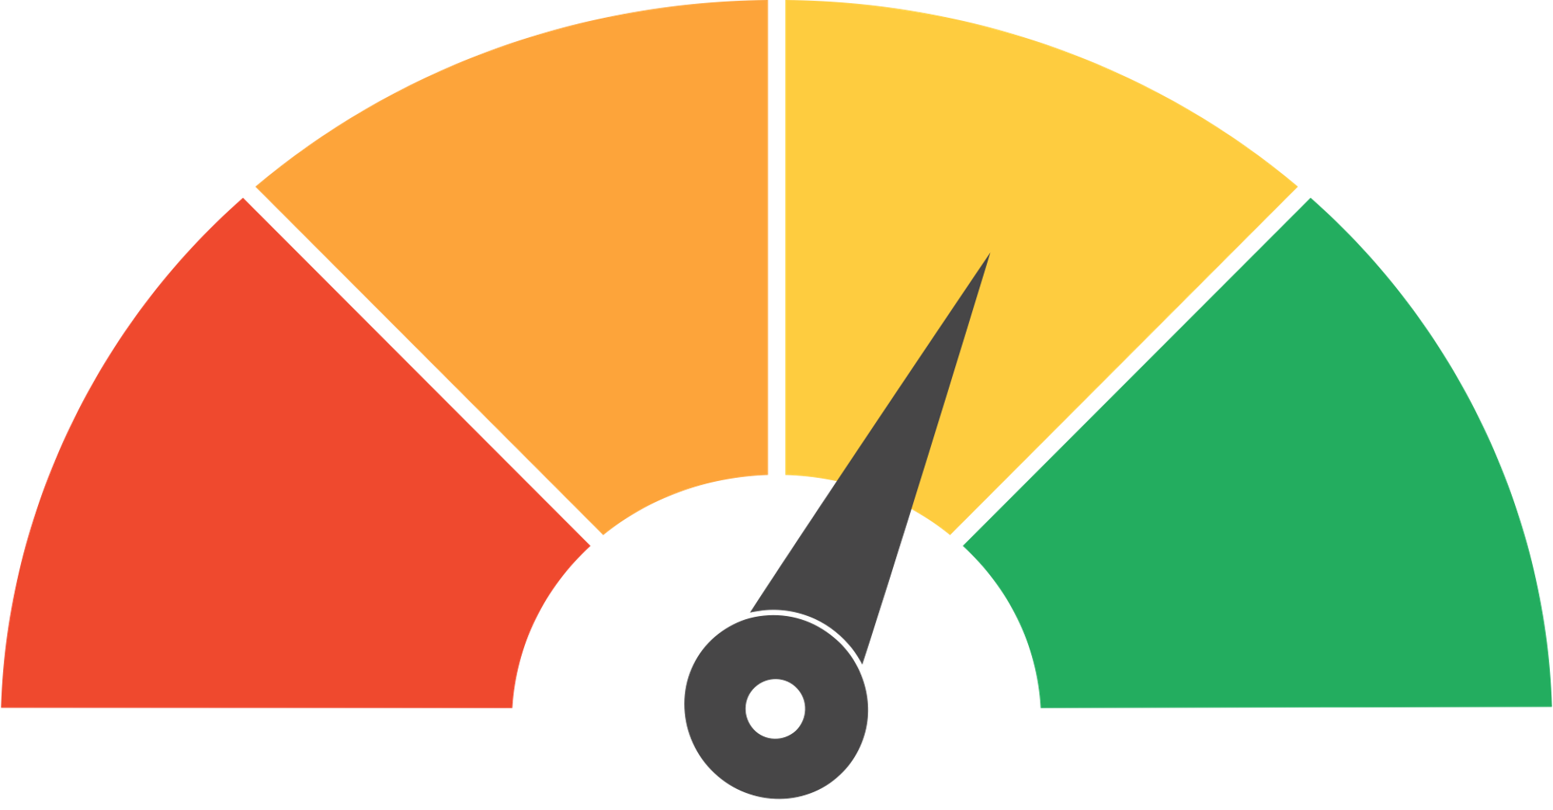
guestbook
Home
Discussion
Conclusion
RISK ASSESSMENT
Jenkins Configuration Errors
02
Docker Image Vulnerabilities
03
Cloud Deployment Issues
01
Risk: Using insecure or outdated base images in Docker could expose the application to security risks.
Mitigation: Use trusted base images, regularly scan images for vulnerabilities, and update dependencies.
Risk: Misconfigured cloud resources (e.g., AWS, GCP) could lead to deployment failures or cost overruns.
Mitigation: Use Infrastructure as Code (IaC) tools (e.g., Terraform) to manage cloud resources and monitor costs.
Risk: Misconfiguration of Jenkins jobs or plugins could lead to pipeline failures.
Mitigation: Test Jenkins configurations in a staging environment before production use. Maintain backup configurations.

Slide 9

guestbook
Home
Discussion
Conclusion
MITIGATION PLAN
Testing & Validation
02
Monitoring & Alerts:
03
Documentation & Knowledge Sharing:
01
Conduct thorough testing at each stage (build, test, deploy) to catch issues early.
Use automated testing tools (e.g., Selenium, JUnit) for comprehensive coverage.
Implement monitoring tools (e.g., Prometheus, Grafana) to track pipeline performance.
Set up alerts for pipeline failures or resource bottlenecks.
Maintain detailed documentation for all configurations, playbooks, and pipeline designs.
Conduct team training sessions to ensure everyone understands the pipeline.

Slide 10

guestbook
Home
Discussion
Conclusion
KPIS (KEY PERFORMANCE INDICATORS)
That is the explanation of the project that will be worked on, this project has great potential to meet the needs of the growing market and achieve significant profits in a short time.

Slide 11

guestbook
Home
Discussion
Conclusion
KPIS (KEY PERFORMANCE INDICATORS)
1- Pipeline Efficiency :
Build Time: Time taken to build and package the application (target: < 5 minutes).
Deployment Time: Time taken to deploy the application to the cloud (target: < 10 minutes).
Pipeline Success Rate: Percentage of successful pipeline runs (target: 95%+).
2- System Reliability :
System Uptime: Percentage of time the application is available (target: 99.9%).
Mean Time to Recovery (MTTR): Average time to recover from a failure (target: < 30 minutes).
3- Resource Utilization :
Cloud Cost Efficiency: Cost of cloud resources used for deployment (target: within budget).
Container Resource Usage: CPU and memory usage of Docker containers (target: < 70% utilization).
4- User Adoption & Satisfaction :
User Adoption Rate: Percentage of development teams using the pipeline (target: 90%+).
User Feedback Score: Satisfaction score from developers and stakeholders (target: 4/5 or higher)

Slide 12




guestbook
Home
Discussion
Conclusion
Thank You
www.guestbook.com
Cairo, Egypt

